Slide 1

College Market Application
Team: College Market
David Gross, Bruce Lopez, Sarah Johansen, Viktoria Karpitsky

Slide 2
Problem Statement
Living in a major city and attending the University sometimes makes it difficult for students to either purchase, sell, or trade school item safely and efficiently. Currently, students have few options to purchase, sell or trade their items. Students have a difficult time selling their college items and need more of a centralized network to purchase, sell, and trade items
Our goal is to create a user-to-user network to advertise selling, purchasing, or exchanging items within a small network of students at the same university. This application will allow users to reach others to purchase, sell, or trade items in a more safe, efficient, and local environment.

Slide 3
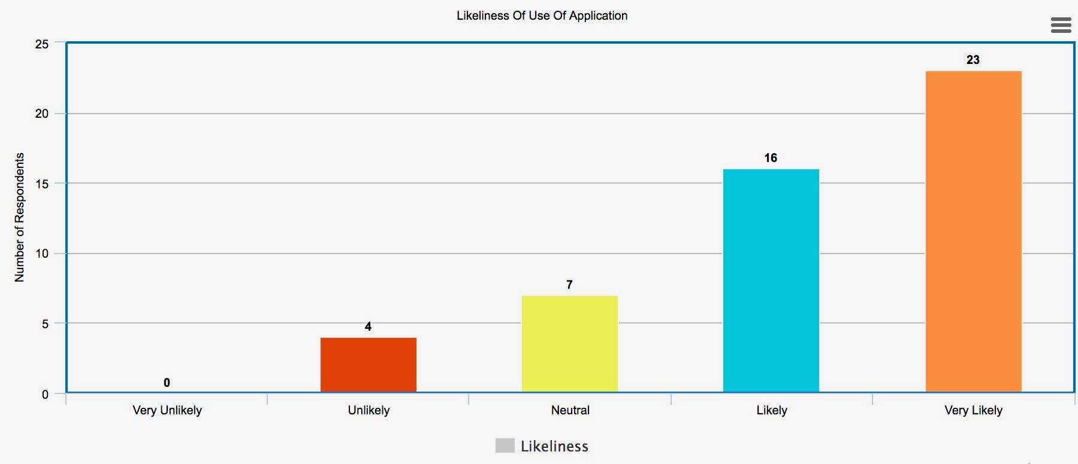
Needfinding results

Slide 4
Design goals
Improve purchasing, selling, and trading
Diminishing safety concerns with the user/student having to meet people in potentially unsafe environments
Allowing the user a better peace of mind and confidence knowing that the buyer or seller is a student as well
Drastically minimizing wait time for selling or receiving items.
Great user-to-user communication

Slide 5
Design goals (Continued)
Learnability
Cost Efficient
Security
Validation

Slide 6


Persona/s
Name: Jess
Student ID: 800123456
Occupation: Barista, graduating senior
Interests: Coffee, Buzzfeed, Feminism
Goals: Graduating UNCC with a B.A in Women’s Studies. Needs to get rid of old textbooks, unused items, university merchandise. No trading because she is finishing up school and has no need for course-related materials. Cleaning out her dorm she found books from her prereqs class and knows a lot of students will be taking those intro classes and wants to sell her books, but doesn’t have the time to put everything up on craigslist or ebay. Wishes there was an easier and quicker way to get rid of everything.
Name: Mario
Student ID: 800456123
Occupation: HS graduate, details cars
Interests: Cars, racecar, engineering
Goals: Mario is excited to start his college career in engineering, but hears that professors and classes are tough and wants to make sure everything goes right. His car detailing job has been slow, so he has been low on money. When he looked up the books he needs for his first semester classes, he was appalled that he would need to spend hundreds of dollars on books alone! He tries to find some of these items online for cheaper, but has failed. Now he wishes he could just ask students who have already taken the course if they want to sell or trade them to him.

Slide 7
Scenario/s
Scenario One:
A student is graduating and moving to a different city and needs to sell old items from their dorm in a quick and a safe way. A new student is looking for items for his new dorm. The graduating student post item on the College market app. The new student is looking for items on the college market app. The new student see some item that he likes. The new student contact the graduating student to purchase the item. The graduating student send the new student a time and a meet up location at the university. The new and graduate student meet up and finish the deal. The graduate student sold his item and the new student bought the item he wanted without leaving the university.
Scenario Two:
Student A need to sell a textbook. The student create a listing on the college market and post the textbook for sell. Student B is looking on the college market and see the textbook they need, so he contacts the student A. Student A get a message from Student B about the textbook he posted on the college market app. Student A response to the message and set up a place and time within the university to meet up. Student A and Student B meet up and the deal is done. Student A makes more money and Student B saves money on the textbook. Both Students are happy.

Slide 8
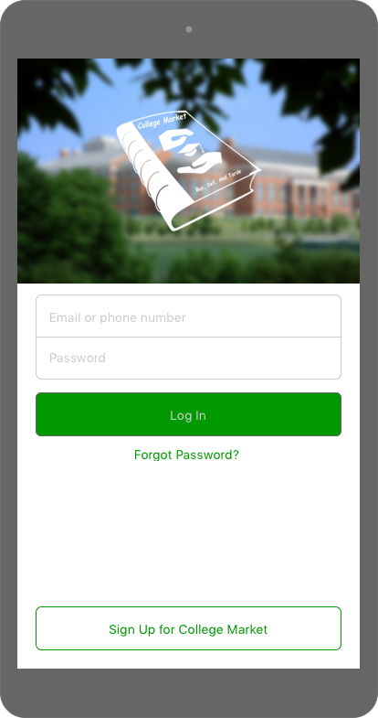
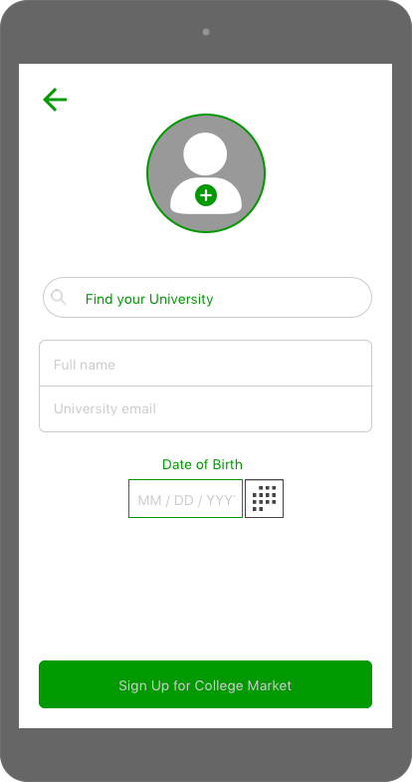
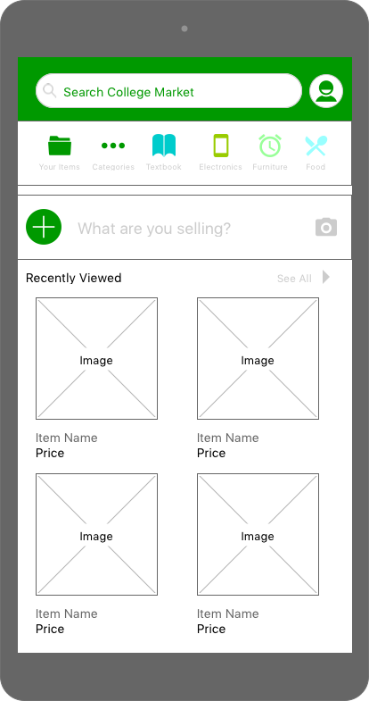
Design I

Slide 9
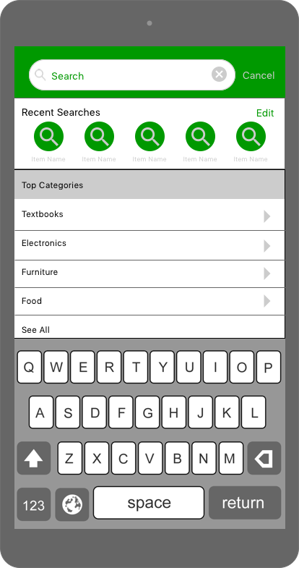
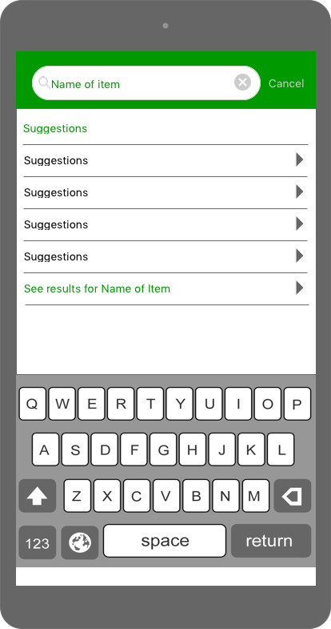
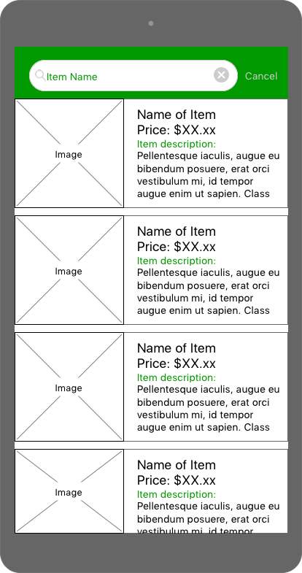
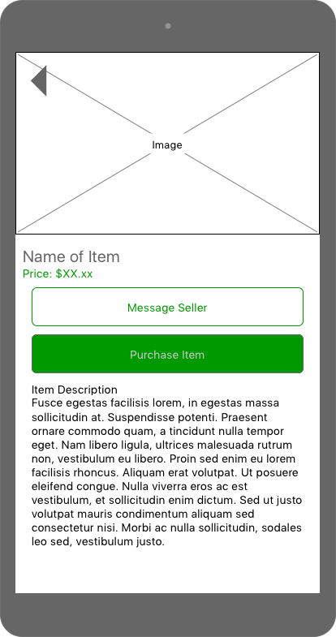
Design I

Slide 10
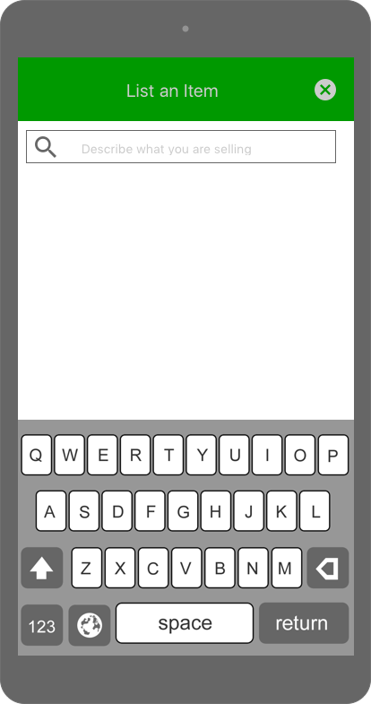
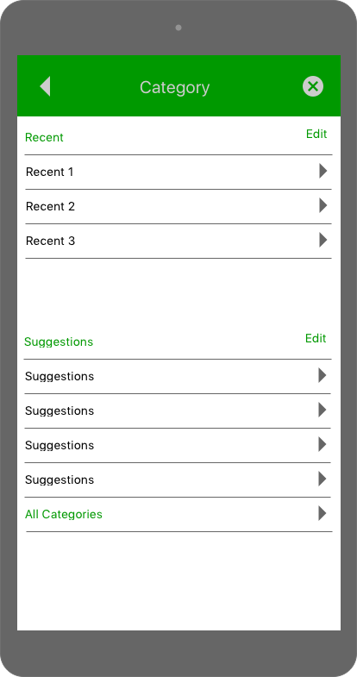
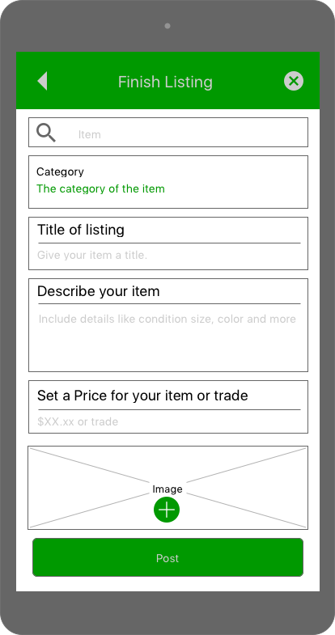
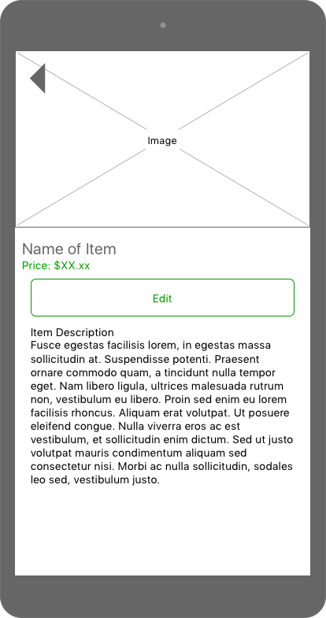
Design I

Slide 11
Design I
This design reflects a simple outline of what the application will portray to the user. It begins with the user needing to either sign in with their email and password or sign up for the application using their school email. This initial step provides the security that the user is indeed a university student with a student ID and that all other users are students as well.
The next screens show the user the different categories shown that can be searched through and top suggested items. These features show the user that it keeps track of what items are being viewed the most and the relevant items for the user. The final screen shows the items that are narrowed down by the user’s selections for what exactly they are looking for, the price of that item, and a description for that item. Then the user is prompted to contact the other user by email to buy that item.

Slide 12
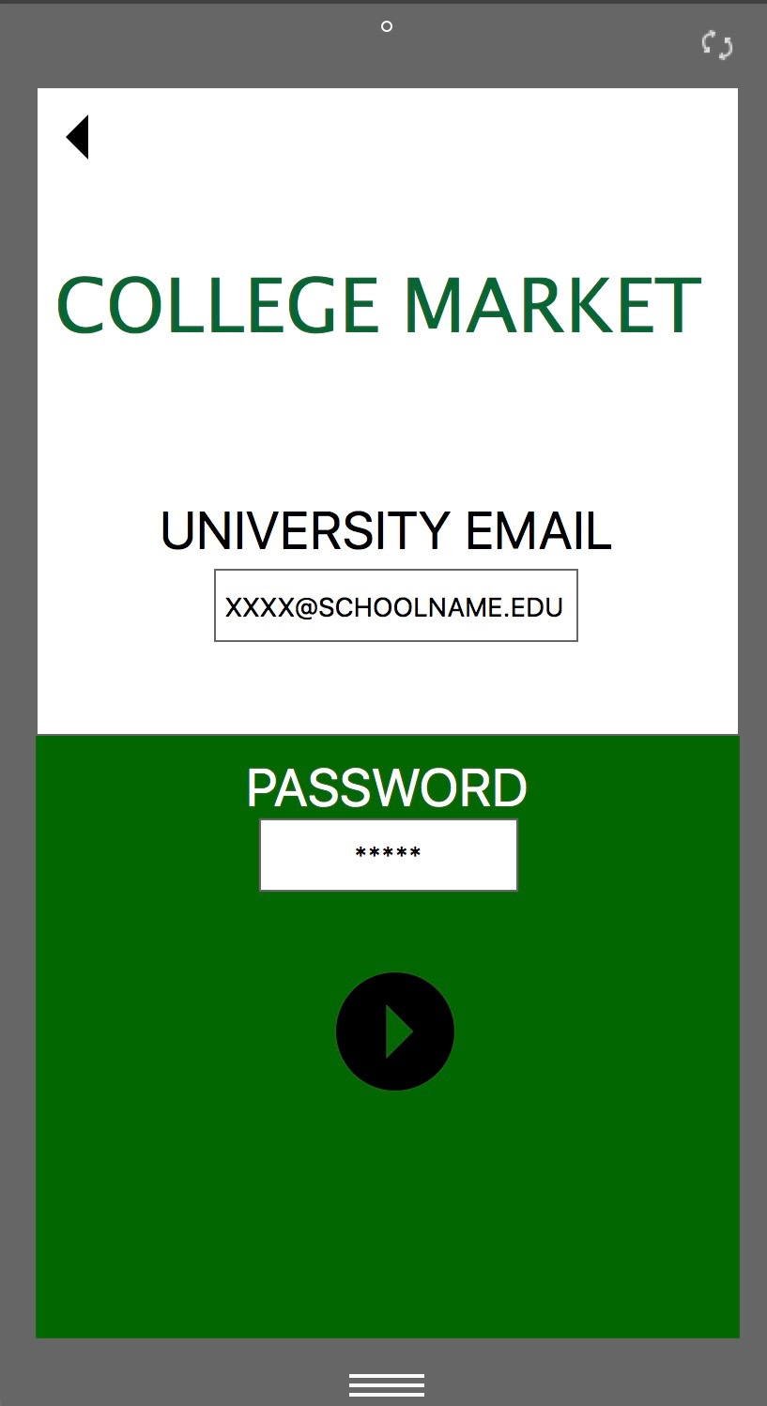
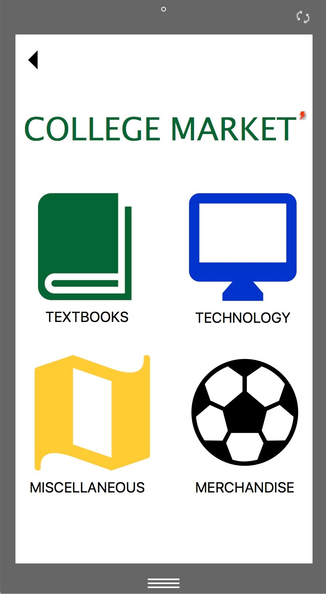
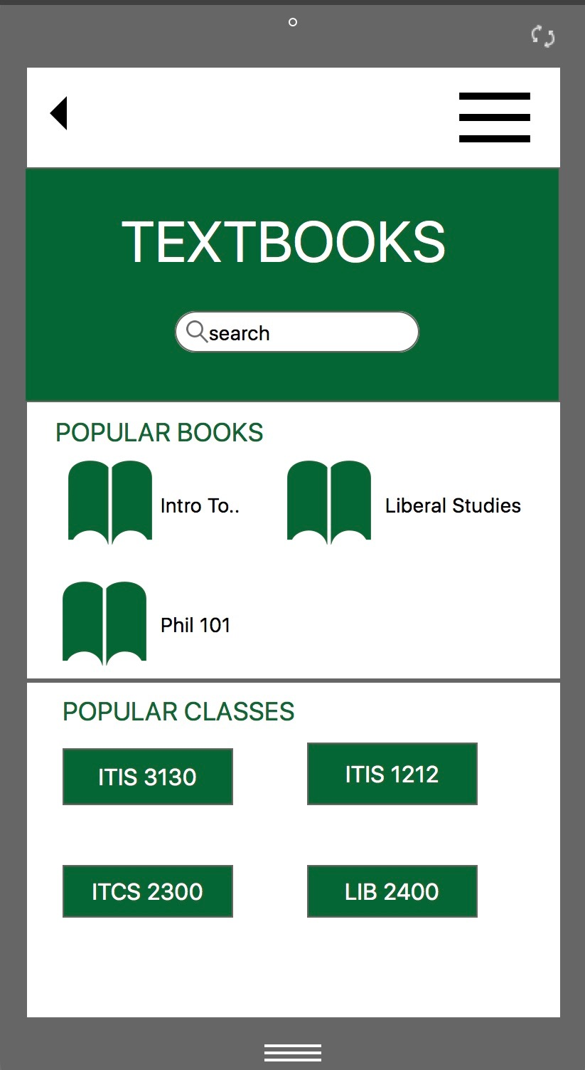
Design II

Slide 13
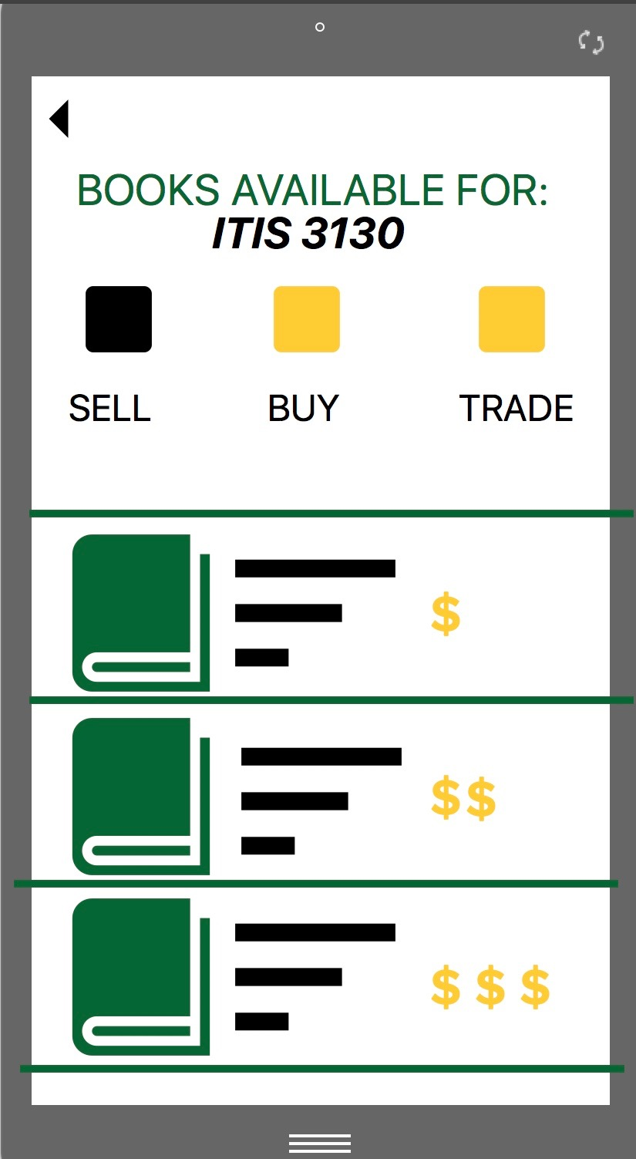
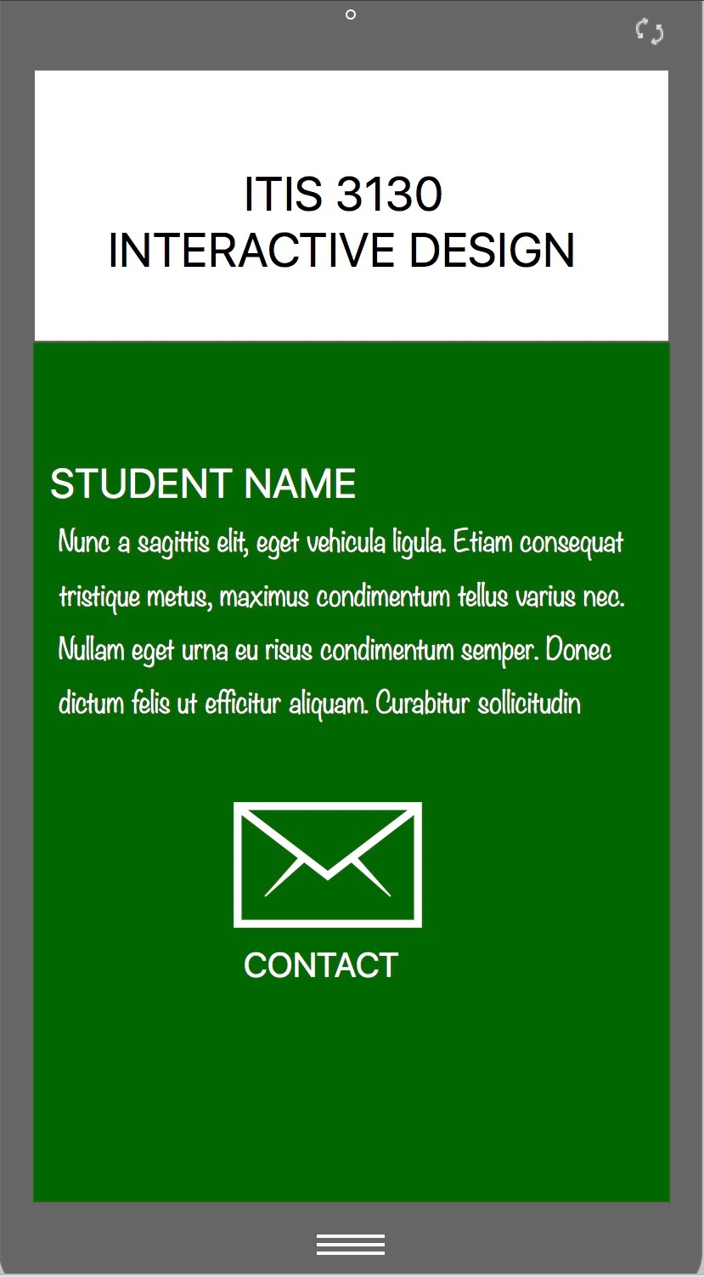
Design II

Slide 14
Design II
The initial screen is a basic login page that a student uses with their university login. Logging in takes you to the main menu which shows as icons. Once you click on one of these item icons it takes you to another screen where the user can choose amongst searching for the item, frequently searched items, or popular classes. After the student chooses their item of choice, they are brought to a menu where they choose if they’re looking to buy, sell, or trade the item (more than one choice can be made) . According to their choice, the item are then listed in ascending order (price low to high). The final screen brings them to a detailed explanation of that item and how to contact the owner to further obtain the item.
Overall, this visual design is pretty effective. It is simple, minimalistic, and to the point. A user isn’t overloaded with icons and information consistently throughout the application. There is one color scheme that is based on the UNCC colors and the fonts are consistent in the whole application. The color scheme also sticks to which item category the user chooses. The grids, sections, and dividers help to separate content to keep it less cluttered and out of order. Icons are used throughout the whole application since it is easier than having to upload images of actual textbooks which can be difficult to read or bad quality.

Slide 15
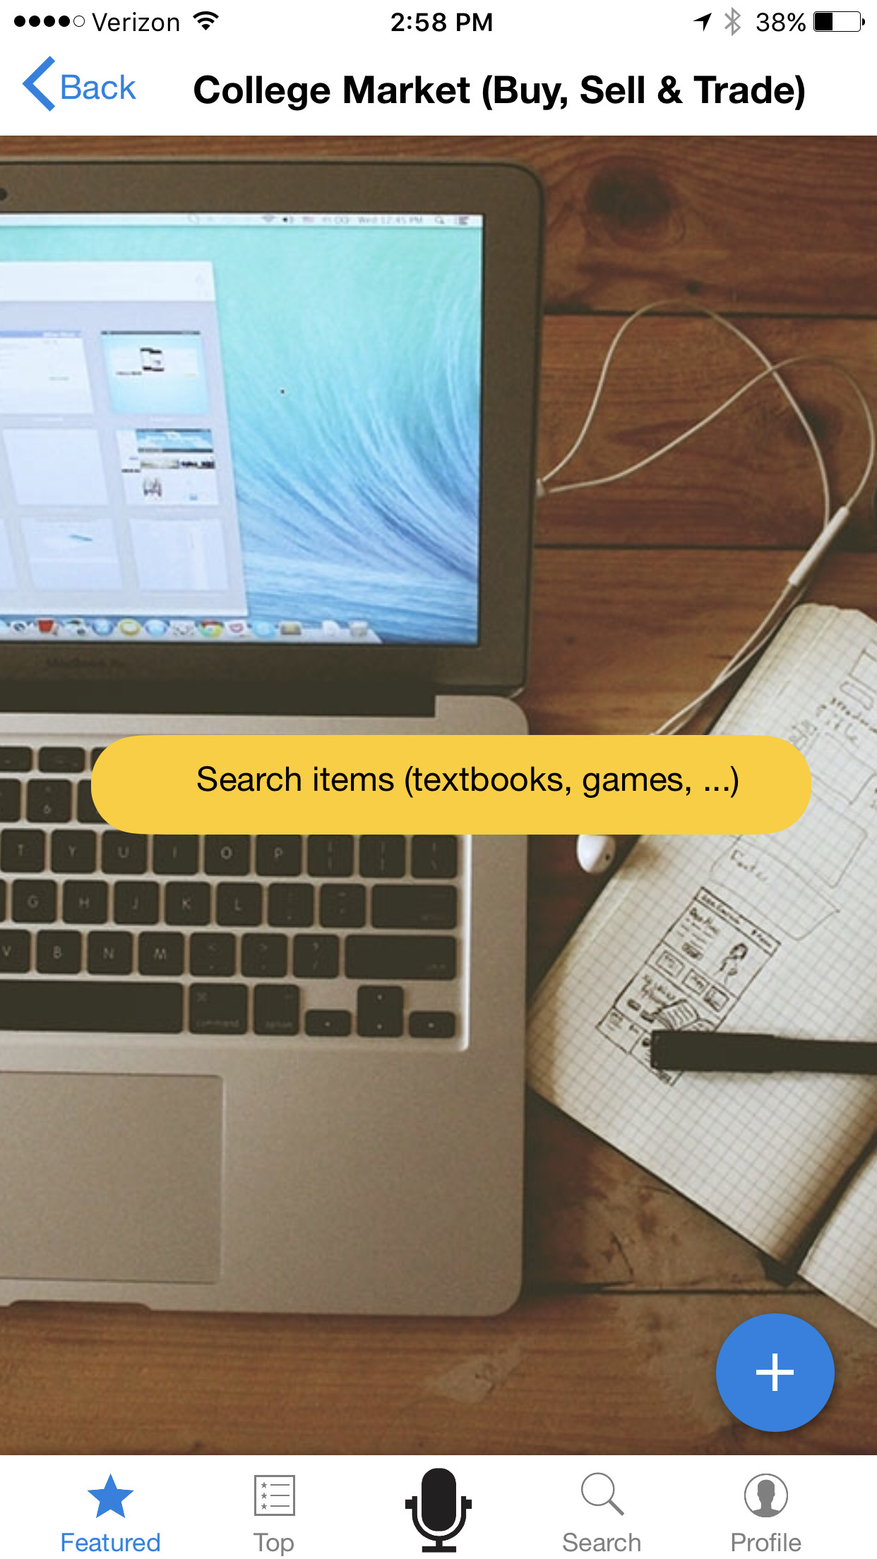
Design 3 (non traditional interaction modality)
Speech Interface
Similar to Amazon Alexa on the Amazon echo
The user click on the microphone icon to turn on speech interface called Becky
Becky allows the user to search for items and send emails
User navigates between different features by speech-recognition
User speaks to application like he would with a person.
Notes:
Speech interface

Slide 16
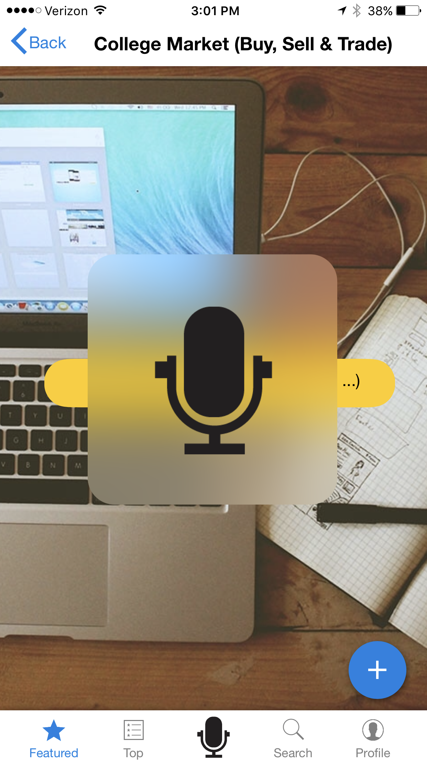
Here is example of the Speech Interface
Black text is the user & White text is the speech interface
“Becky, show me books available for ITIS 3130” Sure, here’s what I found: 10 Interactive Design books for sale 5 Design of everyday Things for trade
“Becky, I’m interested in the Interactive Design books.” Ok, there are multiple editions available, should I show you the latest edition?
“Yes!” Ok here are the top 3 available Interactive Design 4th edition books on campus. Person 1 Contact $$$
Person 2 Contact $$
Person 3 Contact $
“Becky, contact Person 2” Ok, Email sent to Person 2!
Notes:
Speech Interface

Slide 17

Affordances: Picture of microphone from the application appearing on phone.
Signifier: Microphone “Icon” with ripple effect appears to indicate application is activated.

Slide 18
Evaluation and Selection of One Design
The design goals that we had were to have a learnable application that any user can quickly become accustomed to so that they can buy, sell, or trade their school items efficiently and safely. Design II best reflects our goals because it is a simple layout that asks the user for their student log-in to make an account/sign in (safety), has picture icons for the user to select the category (learnability), allows the user to view the items based off of price and description (efficiency), and has a confirmation window when the user sends an email to the other user for the item chosen (validation). To make our design choice better, we would add more steps on how to verify students(to show that it ensures security), validate payments(Paypal button maybe) or give more information on contacting a student.

